Slide 1

LIFE OF A
Steve Kobes
skobes@chromium.org
June 2018
slides: bit.ly/lifeofapixel
"The unexamined pixel is not worth rendering."
— Socrates
Notes:
Welcome to "Life of a Pixel".

Slide 2
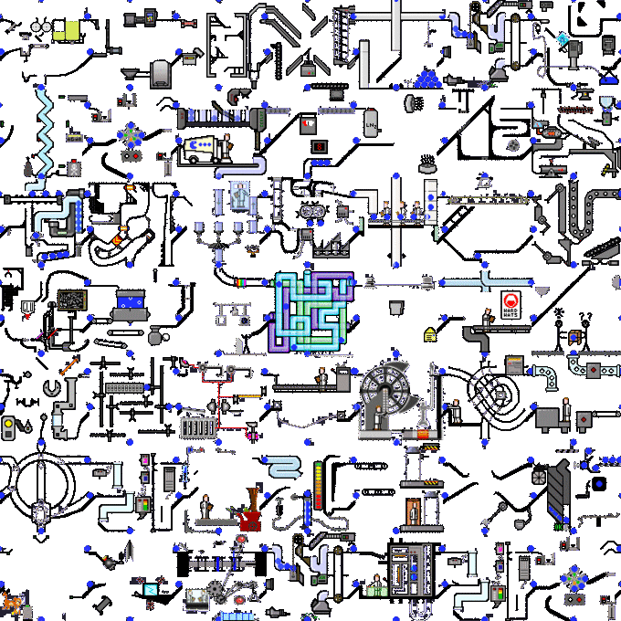



LIFE OF A
magic
web content
pixels
Notes:
This talk is about how Chrome turns web content into pixels. The entire process is called "rendering".
We'll describe what we mean by content, and what we mean by pixels, and then we'll explain the magic in between.

Slide 3




LIFE OF A
68 69.0.3445.0 70
June 2018
Notes:
Chrome's architecture is constantly evolving. This talk connects high-level concepts (which change slowly) to specific classes (which change frequently).
The details are based primarily on what is currently shipping in the canary channel (M69), but a few of the biggest future refactorings are mentioned in passing.

Slide 4
(web) content
HTML
CSS
JS
<p> hello </p>
= Hyper-Text Markup Language
= Cascading Style Sheets
p { color: red }
selector
property
= JavaScript
p.innerHTML = "goodbye";
(also images, video, WebAssembly, ...)
Notes:
"Content" is the generic term in Chromium for all of the code inside a webpage or the frontend of a web application.
It's made of text, markup (surrounding the text), styles (defining how markup is rendered), and script (which can modify all of the above dynamically).
There are other kinds of content, which we won't cover here.

Slide 5
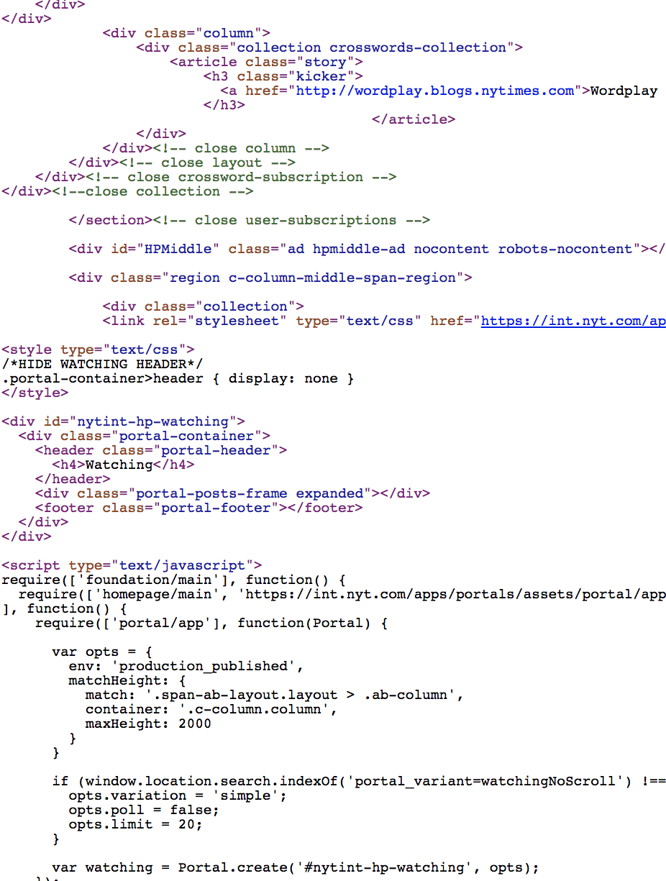

content
https://www.nytimes.com
Notes:
A real webpage is just thousands of lines of HTML, CSS, and JavaScript delivered in plain text over the network.
There's no notion of compilation or packaging as you might find on other kinds of software platforms - the webpage's source code is the input to the renderer.

Slide 6
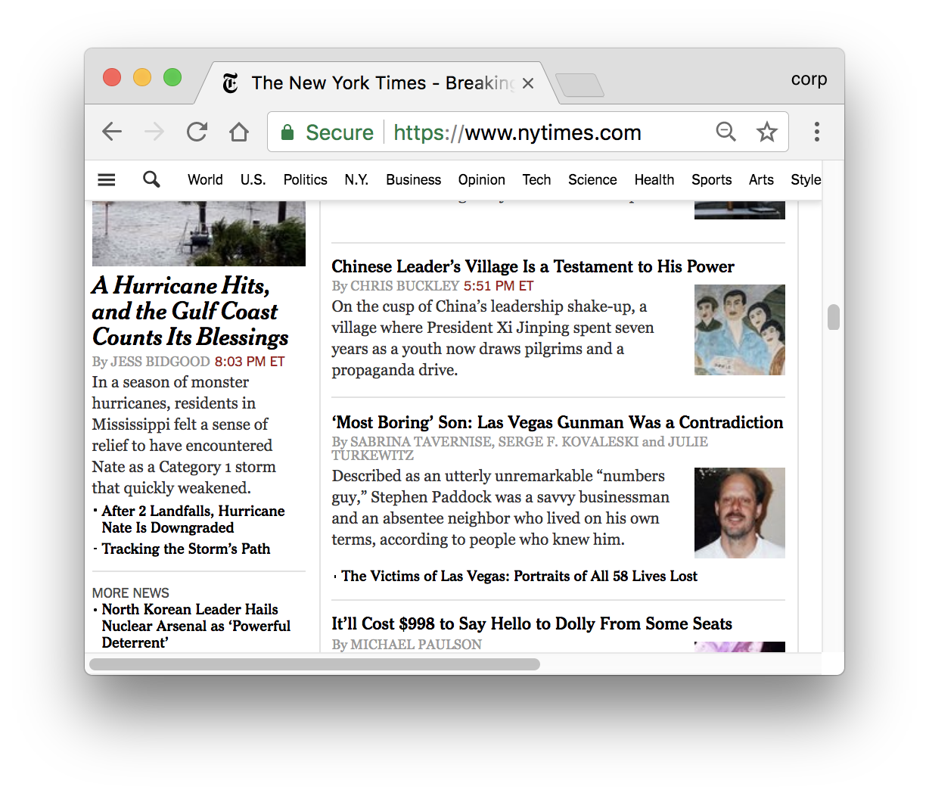
content
NOT "content"
content::WebContents
sandboxed renderer process
Blink
Notes:
Architecturally, the "content" namespace in the Chromium C++ codebase is responsible for everything in the red box.
Contrast with tab strip, address bar, navigation buttons, menus, etc. which live outside of "content".
Key to Chrome's security model: rendering happens in a sandboxed process.

Slide 7






pixels
( )
( )
( ?)
Operating System
Device Driver
#include <GL/gl.h>
textures
shaders
vertex buffers
…
Notes:
At the other end of the pipeline we have to get pixels onto the screen using the graphics libraries provided by the underlying operating system.
On most platforms today, that's a standardized API called "OpenGL". On Windows there's an extra translation into DirectX. In the future, we may support newer APIs such as Vulkan.
These libraries provide low-level graphics primitives like "textures" and "shaders", and let you do things like "draw a polygon at these coordinates into a buffer of virtual pixels". But obviously they don't understand anything about the web or HTML or CSS.

Slide 8
goals
render content into pixels
build data structures to enable updating the rendering efficiently
JavaScript
user input
asynchronous loading
animations
scrolling
zooming
update
update
update
initial render
time
Notes:
So the goal of rendering can be stated as: turn HTML / CSS / JavaScript into the right OpenGL calls to display the pixels.
But keep in mind a second goal as we describe the pipeline: We also want the right intermediate data structures to update the rendering efficiently after it's produced, and answer queries about it from script or other parts of the system.

Slide 9
stages
lifecycle
pixels
content
?
?
<html>...</html>
stage
stage
stage
intermediate data structures
Notes:
We break the pipeline into multiple "lifecycle stages", generating those intermediate outputs.
We'll first describe each stage of a working pipeline, then come back to the notion of efficient updating and introduce some concepts for optimization.

Slide 10
parsing
HTMLDocumentParser
<div>
<p> hello </p>
<p> world </p>
</div>
Document
(always the root)
HTML
(these tags are optional)
BODY
builds
DIV
P
HTML tags can nest
an object model reflects the containment relationships
Text
P
Text
Notes:
HTML tags impose a semantically meaningful hierarchical structure on the document. For example, a <div> may contain two paragraphs, each with text. So the first step is to parse those tags to build an object model that reflects this structure.

Slide 11

DOM
Document
This is the
Document
Object
Model.
The DOM
is a tree!
parents
children
siblings
HTML
BODY
DIV
P
Text
P
Text
Notes:
If you've taken computer science classes you may recognize this as a "tree".

Slide 12
DOM
The DOM is both
Chrome's internal representation AND
the API exposed to JavaScript
Document
HTML
BODY
DIV
var div = document.body.firstChild;
var p2 = div.childNodes[1];
p2.appendChild(document.createElement("span"));
p2.foo = {arbitrary: "state"};
P
Text
P
[ JS ]
Text
V8
[bindings]
Notes:
The DOM serves double duty as both the internal representation of the page, and the API exposed to script for querying or modifying the rendering.
The JavaScript engine (V8) exposes DOM web APIs as thin wrappers around the real DOM tree through a system called "bindings".

Slide 13
style
/* every <p> has red text */
p { color: red }
Document
HTML
BODY
DIV
P
selects
hello
world
Text
P
Text
Notes:
Having built the DOM tree, the next step is to process the CSS styles.
A CSS selector selects a subset of DOM elements that its property declarations should apply to.

Slide 14

style
font-weight: bold;
hello
margin-left: 2cm;
hello
outline: dashed blue;
hello
transform: rotate(20deg);
hello
background: url(kitten.jpg);
hello
Notes:
Style properties are the knobs by which web authors can influence the rendering of DOM elements.
There are hundreds of style properties.

Slide 15
style
/* every other <p> in any <div> without class="foo" */
div:not(.foo) > p:nth-of-type(2n) {
color: red !important;
}
p {
color: blue;
}
selectors can be complex!
declarations may conflict!
Notes:
Furthermore, it's not trivial to determine which elements a style rule selects.
Some elements may be selected by more than one rule, with conflicting declarations for a particular style property.

Slide 16
style
CSSProperties.json5
CSSParser
div:not(.foo) > p {
color: red !important;
}
p {
margin: 0;
border-left-color: blue;
...
}
...
make_css_property_subclasses.py
builds
border_left_color.cc
StyleSheetContents
StyleRule
CSSPropertyValueSet
BorderLeftColor
CSSSelectorList
CSSPropertyValue
CSSColorValue
CSSSelector
property_
value_
0x0000FFFF
Notes:
The CSS parser builds a model of the style rules.
Style rules are indexed in various ways for efficient lookup.
(Property classes are auto-generated at build time by Python scripts.)

Slide 17
style
StyleSheetContents
StyleSheetContents
StyleSheetContents
Document::UpdateStyle
StyleResolver::StyleForElement
Document
ComputedStyle
HTML
ComputedStyle
ComputedStyle {
fontWeight = ...
marginLeft = ...
outline = ...
transform = ...
background = ...
... }
BODY
ComputedStyle
DIV
ComputedStyle
P
ComputedStyle
Text
ComputedStyle
P
ComputedStyle
Style recalc: for every node in the DOM tree, compute the value of every style property.
Text
ComputedStyle
Notes:
Style resolving (or recalc) takes all the parsed style rules from the active style sheets in the document, including a set of default styles supplied by the browser, and computes the final value of every style property for every DOM element. These are stored in an object called ComputedStyle which is just a giant map of style properties to values.

Slide 18
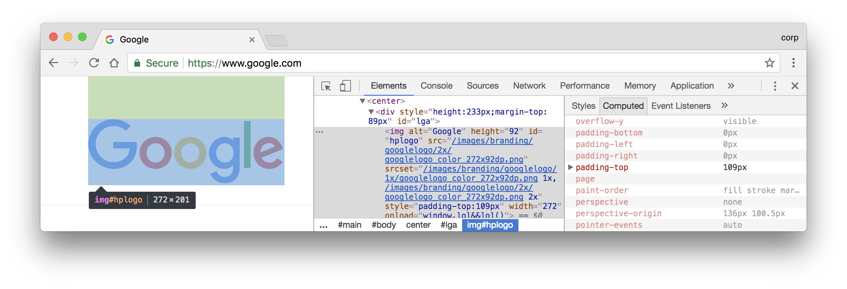
style
getComputedStyle(element)["padding-top"]
[ JS ]
Notes:
Chrome developer tools will show you the "computed style" for any DOM element. It's also exposed to Javascript. These are based on Blink's ComputedStyle object (but a few properties are augmented with layout data).

Slide 19
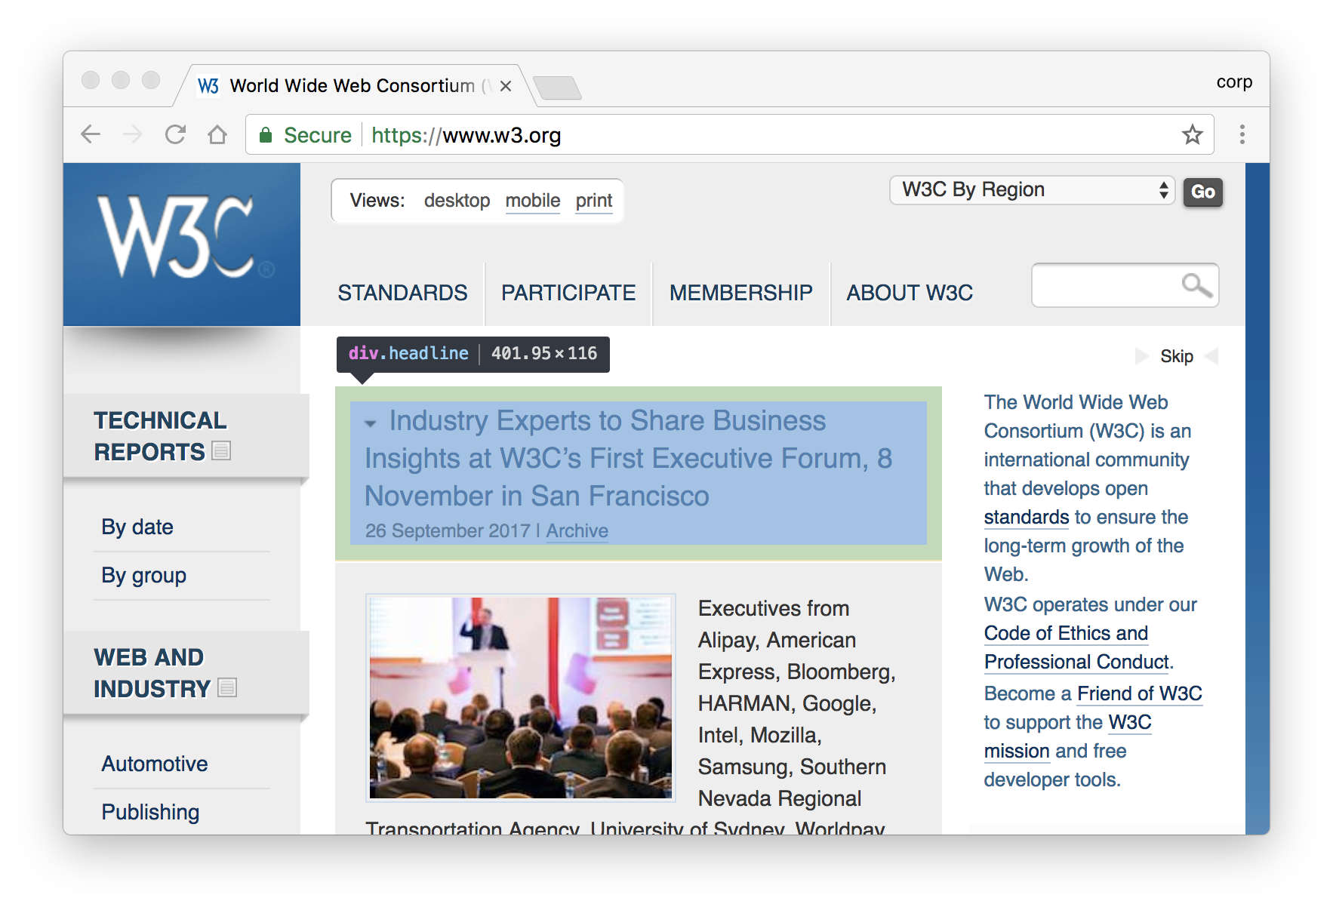
layout
DIV
LayoutObject
LayoutRect
x = 183
y = 148
width = 402
height = 116
Notes:
Having built the DOM and computed all the styles, the next step is to determine the visual geometry of all the elements.
So for a block-level element we're computing the coordinates of a rectangle corresponding to the geometric region of the content area that the element occupies.

Slide 20
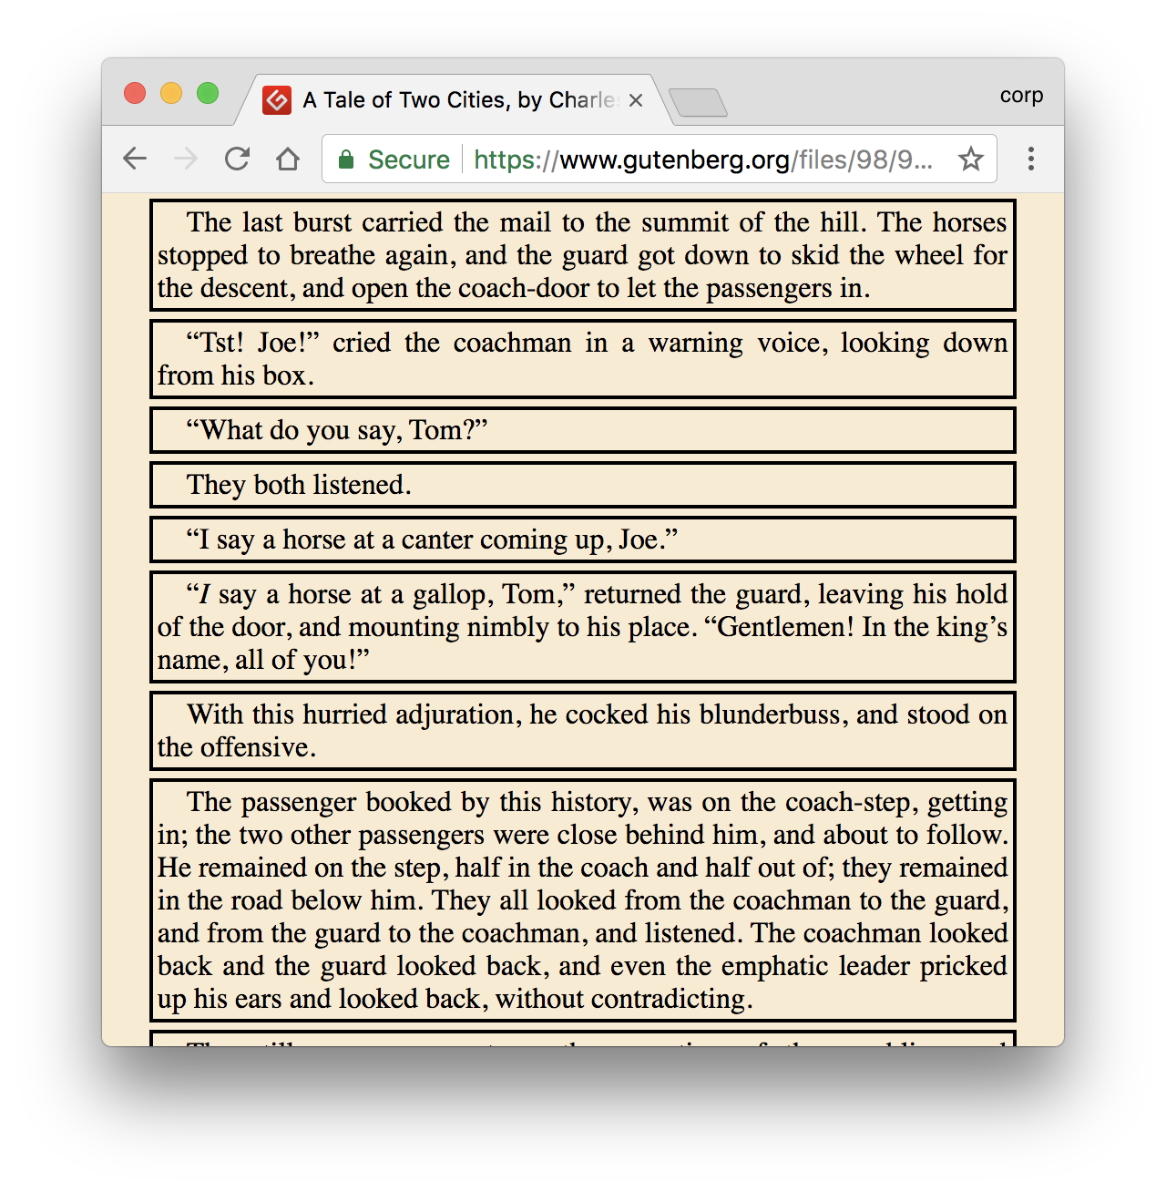
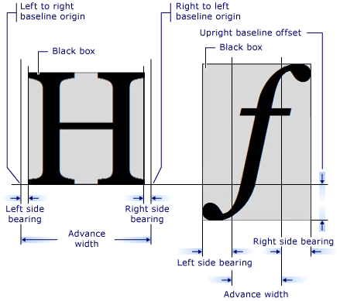
layout
Simple "block" layout objects are placed one after another, flowing down the page.
block flow
(Line breaking is not simple.)
Notes:
In the simplest case, layout places blocks one after another in DOM order, descending vertically. We call this "block flow".
To know the height of a block, we must measure the text, using the font from the computed style, to determine where the lines break.

Slide 21
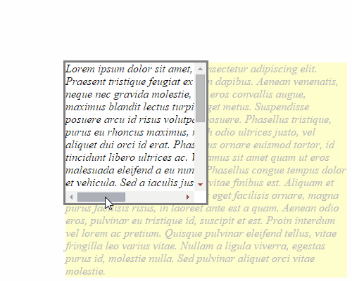
layout
The contents of a layout object can overflow its border box.
CSS
IS
AWESOME
border box rect
layout overflow rect
Overflow can be visible, hidden, or scrollable.
Notes:
Layout may compute multiple kinds of bounding rects for a single layout object.
For example, when there is overflow, layout computes both the border box rect and the layout overflow rect.
If a node's overflow is scrollable, layout also computes scroll boundaries and reserves space for scrollbars.
The most common scrollable DOM node is the document itself, which is the root of the tree.

Slide 22
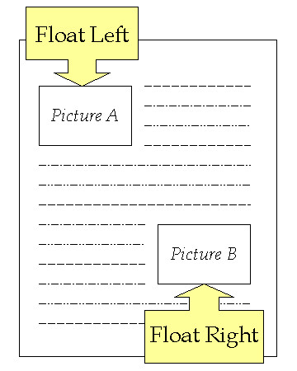
layout
Other kinds of layout are even more complex.
<table>
float: left
column-count: 3
display: flex
writing-mode: vertical-lr
...
Notes:
More complex layouts are needed for table elements or styles that specify things like breaking content into multiple columns, or floating objects that sit to one side with content flowing around them, or East Asian languages that have text running vertically instead of horizontally.
Notice how DOM structure and ComputedStyle values like "float: left" are inputs to the layout algorithm. Each pipeline stage uses the results of the previous stages.

Slide 23
layout
Document
LayoutView
LayoutObject
HTML
LayoutBlockFlow
LayoutText
BODY
LayoutBlockFlow
LayoutBoxModelObject
DIV
LayoutBlockFlow
LayoutBox
P
LayoutBlockFlow
Text
LayoutText
LayoutBlock
P
LayoutBlockFlow
LayoutBlockFlow
Text
LayoutText
LayoutView
DOM tree
layout tree
C++ class hierarchy
Notes:
Layout information is stored in a separate tree, linked to the DOM. The nodes in this tree implement the layout algorithms.
There are different subclasses of LayoutObject, depending on the desired layout behavior.

Slide 24

layout
DOM nodes are mostly 1:1 with layout objects, with some exceptions.
p::before { content: "danger" }
no DOM node!
LayoutInline {<pseudo:before>}
DIV
ComputedStyle {
display: none
}
<span>
split
<p>whoa</p>
span
</span>
LayoutBlockFlow (anonymous)
LayoutInline {SPAN}
LayoutText "split"
LayoutBlockFlow (anonymous)
LayoutBlockFlow {P}
LayoutText "whoa"
LayoutBlockFlow (anonymous)
LayoutInline {SPAN}
LayoutText "span"
no LayoutObject!
Notes:
Usually, one DOM node gets one LayoutObject. But sometimes a LayoutObject has no node, or a node has no LayoutObject.
It's even possible for a node to have more than one LayoutObject.

Slide 25
layout
LocalFrameView::UpdateLayout
LayoutView
LayoutObject::UpdateLayout
LayoutBlockFlow
compute box bounds and overflow
create line boxes
add/remove scrollbars
LayoutBlockFlow
LayoutBlockFlow
LayoutBlockFlow
LayoutText
LayoutBlockFlow
Layout (lifecycle stage) walks the layout tree filling in state describing the visual geometry of each LayoutObject.
layout tree
Notes:
The layout stage runs after the style recalc stage.
First, the layout tree is constructed. Then, we walk the layout tree, filling in the geometry data, and processing side effects of the geometry.

Slide 26

layout
LayoutObject
LocalFrameView::UpdateLayout
(today)
A new system called LayoutNG
will separate inputs from outputs
more cleanly.
NGConstraintSpace
NGLayoutAlgorithm
NGLayoutResult
Notes:
Today, layout objects contain both inputs and outputs of the layout stage, without a clean separation between them.
For example, the LayoutObject acquires ownership of its element's ComputedStyle object.
A new layout system called LayoutNG is expected to simplify the architecture, and make it easier to build new layout algorithms.

Slide 27
paint
LocalFrameView::PaintTree
DIV
LayoutBlockFlow
LayoutObject::Paint
client
PaintCanvas::DrawRect
display item list
DI
DisplayItem
type = kBoxDecorationBackground
DI
DI
DI
…
paint op buffer
PO
DrawRectOp
- rect {x, y, w, h}
- PaintFlags {color, …}
PO
PO
…
Notes:
Now that we understand the geometry of our layout objects, it's time to paint them.
Paint records paint operations into a list of display items.
A paint operation might be something like "draw a rectangle at these coordinates, in this color".
There may be multiple display items for each layout object, corresponding to different parts of its visual appearance, like the background, foreground, outline, etc.
This is just a recording that can be played back later. We'll see why that's useful in a bit.

Slide 28

paint
Paint uses stacking order,
not DOM order.
BODY
DIV .yellow
DIV .green
DOM tree
<div class="yellow"></div>
<div class="green"></div>
<style>
.yellow { z-index: 2; ... }
.green { z-index: 1; ... }
</style>
yellow paints last
Notes:
It's important to paint elements in the right order, so that they stack correctly when they overlap.
The order can be controlled by style.

Slide 29

paint
Each paint phase is a separate traversal of a stacking context.
<div id="green">
green's text
</div>
<div id="blue"></div>
paint phases
(simplified)
backgrounds
floats
foregrounds
outlines
blue after green, but
foregrounds after backgrounds
Notes:
It's even possible for an element to be partly in front of and partly behind another element.
That's because paint runs in multiple phases, and each paint phase does its own traversal of a subtree.

Slide 30
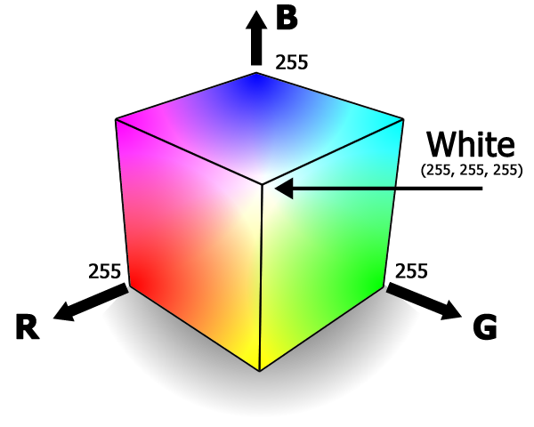
raster
DisplayItem
cc::ResourcePool::InUsePoolResource
…
PaintOp
…
Rasterization turns (part of) a display item list into a bitmap of color values.
bitmap
FFFF
FFFF
FFFF
FFFF
0000
00FF
(red, green,
blue, alpha)
FFFF
FFFF
0000
00FF
FFFF
00FF
0000
00FF
FFFF
00FF
FFFF
00FF
Notes:
The paint operations in the display item list are executed by a process called rasterization.
Each cell in the resulting bitmap holds values for four color channels.

Slide 31

raster
InUsePoolResource
DisplayItem
…
PaintOp
…
GpuRasterBacking
GL texture ID
Rasterization can be accelerated by the GPU.
GPU memory
Notes:
The rastered bitmap is stored in memory, typically GPU memory referenced by an OpenGL texture object.
The GPU can also run the commands that produce the bitmap ("accelerated rasterization").
Note that these pixels are not yet on the screen!

Slide 32

raster
DisplayItem
…
DisplayItemList::Raster
GL calls are issued through the Skia graphics library.
DrawRectOp
{rect, flags}
…
DrawRectOp::RasterWithFlags
SkCanvas::drawRect
GrRenderTargetContext::addDrawOp
another op list
GrOp
AAFillRectOp
…
glDrawElements(...)
SkSurface::flush
GrOp::execute
GrGLGpu::draw
Notes:
Rasterization issues OpenGL calls through a library called Skia. Skia provides a layer of abstraction around the hardware, and understands more complex things like paths and Bezier curves.
Skia is open-source and maintained by Google. It ships in the Chrome binary but lives in a separate code repository. It's also used by other products such as the Android OS.
Skia's GPU-accelerated codepath builds its own buffer of drawing operations, which is flushed at the end of the raster task.

Slide 33
gpu
renderer process
Skia's GL calls are proxied into the GPU process.
Skia
GL_CALL(DrawElements(...))
GPU process
GLES2Implementation::DrawElements
GLApi::glDrawElementsFn
GpuChannelHost
gpu::CommandBuffer
GpuChannelMsg_FlushCommandBuffers
GLES2DecoderImpl
Notes:
Recall that the renderer process is sandboxed, so it can't make system calls directly.
GL calls issued by Skia are actually proxied into a different process using a "command buffer".
The GPU process receives the command buffer and issues the "real" GL calls through a set of function pointers.
Besides escaping the renderer sandbox, isolating GL in the GPU process protects us from unstable or insecure graphics drivers.

Slide 34

gpu
GPU process
The GL functions are dynamically linked.
On Windows, we translate to DirectX.
GLApi::glDrawElementsFn
dlopen("libGLESv2.so")
dlsym("glDrawElements")
ANGLE
LoadLibrary("libglesv2.dll")
GetProcAddress("glDrawElements")
Notes:
Those GL function pointers are initialized by dynamic lookup from the system's shared OpenGL library - or the ANGLE library on Windows.
ANGLE is another library built by Google; its job is to translate OpenGL to DirectX, which is Microsoft's API for accelerated graphics on Windows.
There are also OpenGL drivers for Windows, but historically they have not been very high quality.

Slide 35
gpu
In the future, raster will happen in the GPU process.
renderer process
GPU process
PaintOp
…
Notes:
Moving raster to the GPU process will improve performance.
It's also needed to support Vulkan.

Slide 36

change
We now have a complete pipeline.
But what if state can change?
DOM
style
layout
paint
scrolling
zooming
animations
incremental loading
JavaScript
…
raster
"Change is good."
"Yeah, but it's not easy."
gpu
(in memory)
Notes:
We have now gone all the way from content to pixels in memory.
But note that the rendering is not static.
Running the full pipeline is expensive.

Slide 37
frames
The renderer produces animation frames.
Below 60 frames per second,
scrolling and animations look "janky".
time
VSync signal
= time spent to render the frame
Notes:
Change is modelled as animation frames.
Each frame is a complete rendering of the state of the content at a particular point in time.

Slide 38
invalidation
Each pipeline stage tracks granular asynchronous invalidations.
Node::SetNeedsStyleRecalc()
style
LayoutObject::SetNeedsLayout()
layout
LayoutObject::InvalidatePaint()
paint
Tile::SetInvalidated()
raster
Outputs are reused from previous frames when possible.

Slide 39
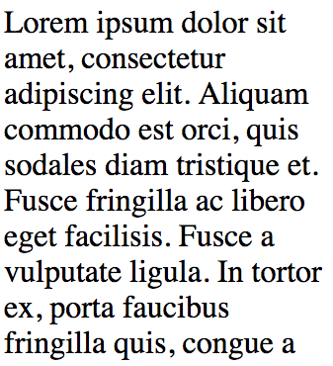

repaint
Paint + raster remain expensive if a large region is transformed…
scroll
all the pixels changed!

Slide 40

jank
… and anything on the main thread competes with JavaScript.
main
time
<script>
mineSomeBitcoins(); // why not?
</script>

Slide 41
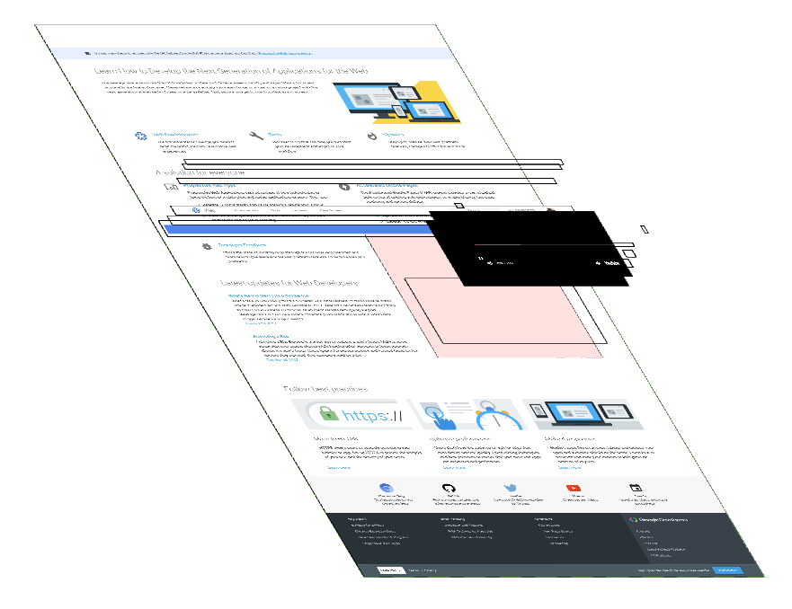
enter: compositing
Decompose the page into layers.
Composite the layers on another thread.
layers in Developer Tools
main
build layers
commit
impl*
draw layers
* ("impl" = compositor thread) ¯\_(ツ)_/¯

Slide 42
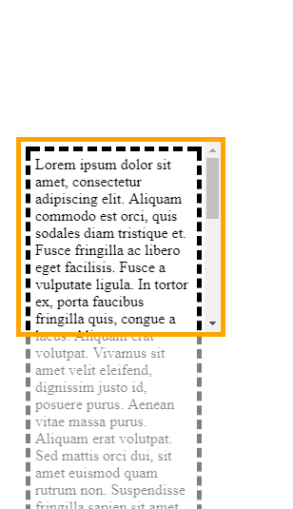


compositing
Pinch Zoom:
a layer scales
Animation:
a layer moves
Scrolling:
a layer moves; another clips

Slide 43
compositing
main
busy
renderer process
impl
scroll
scroll
scroll
The compositor thread
can handle input events.
input from
browser process

Slide 44
layer tree
cc::Layer
Layers are also a tree!
"stacked" by preorder traversal
can clip descendants, or apply effects
A
cc::Layer
A
B
cc::Layer
B
cc::Layer
clip = [...]
cc::Layer
layer tree

Slide 45
layer tree
LayoutView
PaintLayer
cc::Layer
LayoutBlockFlow
LayoutBlockFlow
PaintLayer
cc::Layer
transform: ...
LayoutText
PaintLayer is a
compositing
"candidate".
layer tree
LayoutBlockFlow
layout tree
The layer tree is based on the layout tree.
Notes:
Certain style properties cause a layer to be created for a layout object.
If a layout object doesn't have a layer, it paints into the layer of the nearest ancestor that has one.

Slide 46

layer tree
LayoutBlockFlow
PaintLayer
main layer
applies clip
overflow: scroll
CompositedLayerMapping
scroll layer
scrolling contents layer
Scroll containers
create a whole
set of layers.
scrollbar container layer
horz. scrollbar layer
vert. scrollbar layer
scroll corner layer

Slide 47
compositing update
NEW
compositing update
DOM
style
layout
paint
main
GraphicsLayer::Paint
PaintLayerCompositor::UpdateIfNeeded
cc::Layer
GraphicsLayer
DI
DI
DI
cc::Layer
builds
GraphicsLayer
cc::Layer
GraphicsLayer
Each layer is painted separately.
cc::Layer
Notes:
Building the layer tree is a new lifecycle stage on the main thread. Today, this happens before paint, and each layer is painted separately.

Slide 48
slimming paint
paint
PaintArtifact
cc::Layer
DI
DI
DI
cc::Layer
cc::Layer
transform
clip
effect
scroll
In the future, layers will be determined after paint.
property trees

Slide 49
commit
main
…
paint
cc::Layer
(blocked)
cc::Layer
ready to
commit
copy state
commit
complete
impl
commit
cc::LayerImpl
…
cc::LayerImpl
Notes:
After paint is finished, the commit updates a copy of the layer tree on the compositor thread, to match the state of the tree on the main thread.

Slide 50
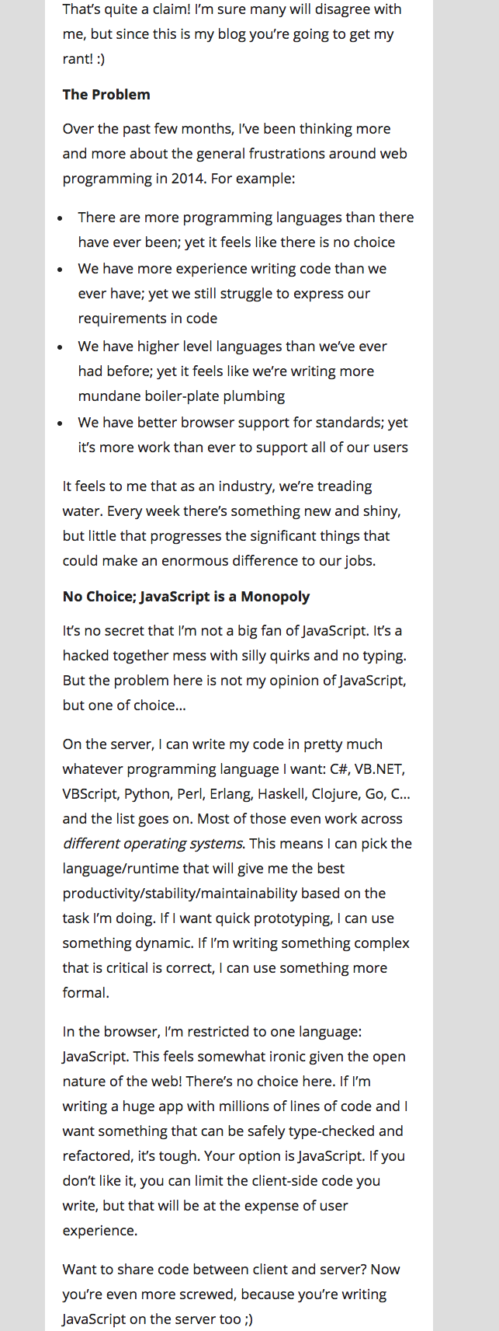
tiling
impl
prepare tiles
rastered
tile
viewport
visible
tiles
raster
raster task
raster
CategorizedWorkerPool
layer
Layers are broken into tiles for raster.
Notes:
Recall: raster is the step after paint, which turns paint ops into bitmaps.
Layers can be large - rastering the whole layer is expensive, and unnecessary if only part of it is visible.
So the compositor thread divides the layer into tiles.
Tiles are the unit of raster work. Tiles are rastered with a pool of dedicated raster threads. Tiles are prioritized based on their distance from the viewport.
(Not shown: a layer actually has multiple tilings for different resolutions.)

Slide 51
drawing
Tiles are "drawn" as quads.
impl
(raster complete)
draw
CompositorFrame
PictureLayerImpl::AppendQuads
DrawQuad
DrawQuaDrawQuad
d
DrawQuad
browser
process
Tile
GPU memory
rect = …
TileDrawInfo
resource_
raster output
CompositorFrame is the "output" of the renderer process.
Notes:
Once all the tiles are rastered, the compositor thread generates "draw quads". A quad is like a command to draw a tile in a particular location on the screen, taking into account all the transformations applied by the layer tree. Each quad references the tile's rastered output in memory (remember, no pixels are on the screen yet).
The quads are wrapped up in a compositor frame object which gets submitted to the browser process.

Slide 52
activation
Drawing can continue while
a new commit is rastered.
commit
pending
tree
raster
LayerImpl
impl
activation
LayerImpl
active
tree
LayerImpl
LayerImpl
LayerImpl
LayerImpl
draw
draw
Notes:
The compositor thread has two copies of the tree, so that it can raster tiles from a new commit while drawing the previous commit.

Slide 53
display (viz)
renderer process
browser process
The display compositor
puts pixels on the screen.
CompositorFrame
Display::DrawAndSwap
DrawQuad
DrawQuad
GLRenderer::DrawTileQuad
GLES2Implementation
CompositorFrame
CompositorFrame
browser UI,
other renderers
GPU process
woohoo
Notes:
The browser process runs a component called the display compositor, inside a service called "viz" (short for visuals).
The display compositor aggregates compositor frames submitted from all the renderer processes, along with frames from the browser UI outside of the WebContents. Then it issues the GL calls to draw the quad resources, which go to the GPU process just like the GL calls from the raster workers.
On most platforms the display compositor's output is double-buffered, so the quads draw into a backbuffer, and a "swap" command makes it visible.
(On OS X we do something a little different with CoreAnimation.)
Finally our pixels are on the screen. :)

Slide 54
review
content
<html>...</html>
renderer process
Blink
main
DOM
style
layout
compositing update
paint
impl
commit
tiling
raster
activate
draw
GPU process
browser process
display

Slide 55
end
LIFE OF A
slides: bit.ly/lifeofapixel
feedback: skobes@chromium.org

